Slide 1
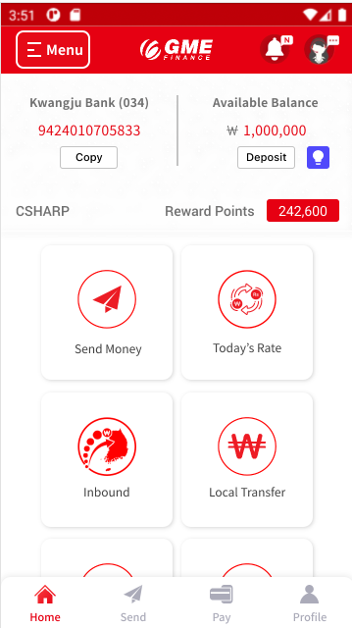


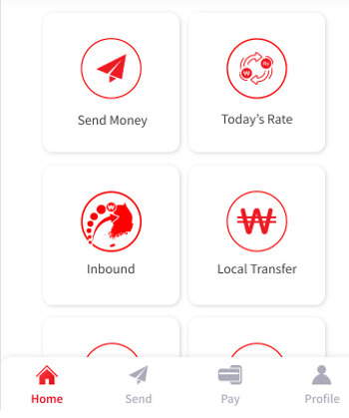

Invite a friend
Spin the Wheel
Carousel
Refer a friend
Event
Event

Slide 2
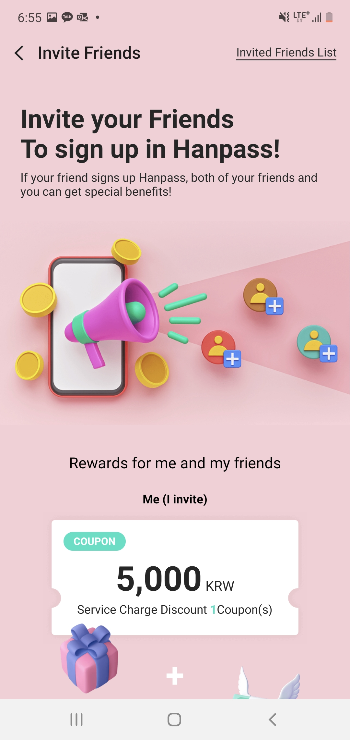
Invite your Friends
To Register GME
Number of Friends invited:
11
Munkhbileg Sundariya 22/03/07 16:54
Subash Poudel 22/03/07 17:11
Invite a friend
Invite a friend
Invite a friend
Event

Slide 3
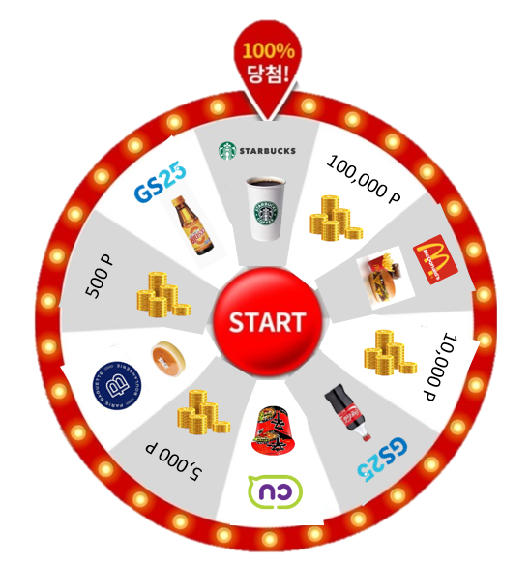
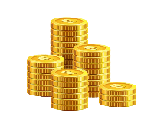
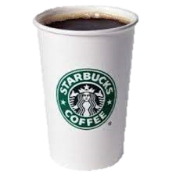
Spin the Wheel and
Win 100,000 point
Share with a friend,
Get more chances to spin the wheel.
If friend who received the link:
Registers GME and send overseas transaction-> 5 chances to spin the wheel
Sends overseas transaction (in case of existing GME customer) -> 2 chances to spin the wheel
Registers GME and spin the wheel -> 1 more chance to spin the wheel
Refer a friend
Spin the Wheel
Share with a friend
Winners:
100,000 point 10 people
10,000 point 1,000 people
Starbucks coupon 25,700 people
Share with a friend
Share with a friend
Event

Slide 4
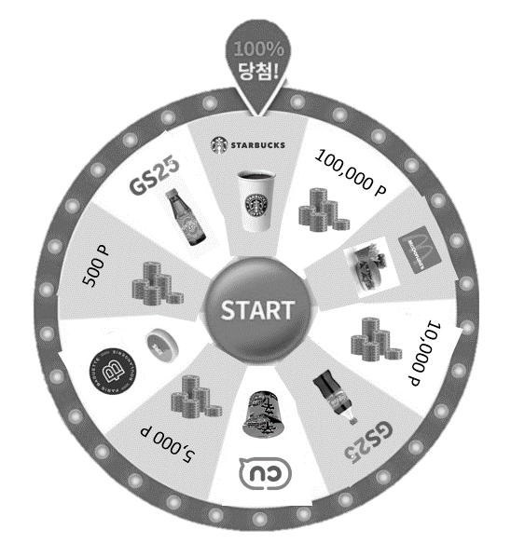
Spin the Wheel and
Win 100,000 point
Share with a friend,
Get more chances to spin the wheel.
If friend who received the link:
Registers GME and send overseas transaction-> 5 chances to spin the wheel
Sends overseas transaction (in case of existing GME customer) -> 2 chances to spin the wheel
Registers GME and spin the wheel -> 1 more chance to spin the wheel
Refer a friend
Spin the Wheel
Share with a friend,
Get more chances to spin the wheel.
Share with a friend
Winners:
100,000 point 10 people
10,000 point 1,000 people
Starbucks coupon 25,700 people
Share with a friend
Share with a friend
Event

Slide 5
Invite a friend
Spin the Wheel
Invite a friend
Event

